Slide 1
Measuring Internal Product Attributes: Size
SE-843: Software Metrics

Slide 2
Size Metrics
Remember, size measures only indicate how much of an entity we have. Size alone cannot directly indicate external attributes such as effort, productivity, and cost. We have seen many complaints about the limitations of size measures.
Size is commonly used as a component to compute indirect attributes such as productivity:
Productivity = Size/Effort
Another example, which was discussed earlier in the book, is defect density:
Defect density = Defect count/Size
Also, size is commonly used in many cost estimation models, which are often used for project planning.

Slide 3
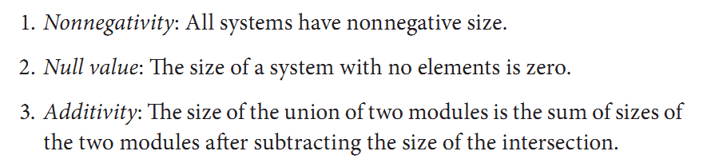
measure of software size

Slide 4
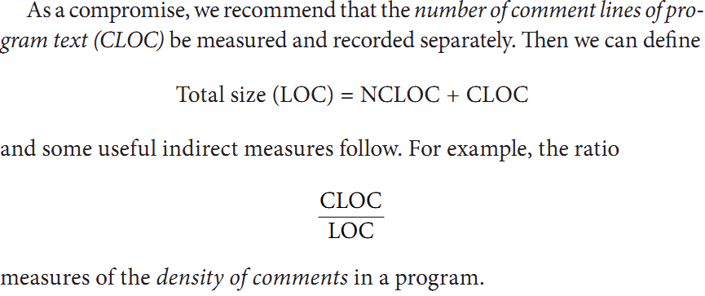
CODE SIZE
Counting Lines of Code to Measure Code Size
• Blank lines
• Comment lines
• Data declarations
• Lines that contain several separate instructions

Slide 5
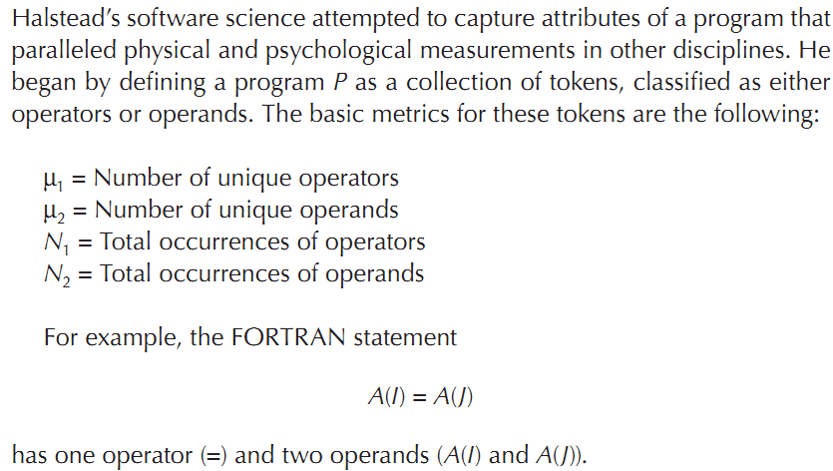
Halstead’s Approach

Slide 6
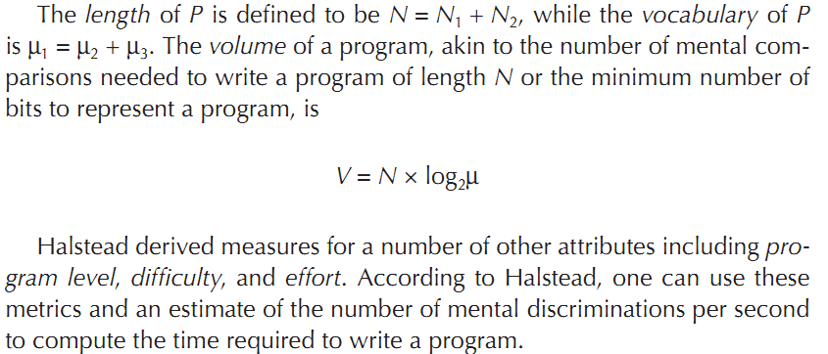
Halstead’s Approach

Slide 7
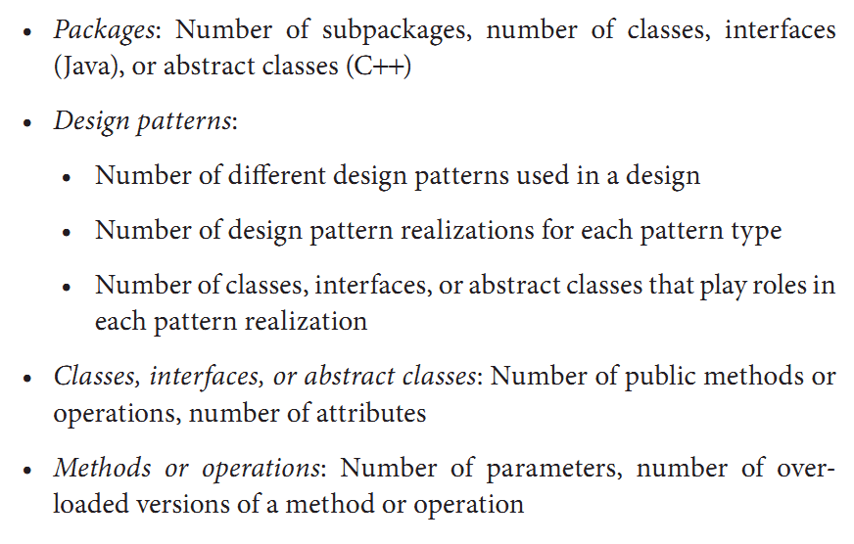
DESIGN SIZE

Slide 8
REQUIREMENTS ANALYSIS AND SPECIFICATION SIZE
i. Use case diagrams: Number of use cases, actors, and relationships of various types
ii. Use case: Number of scenarios, size of scenarios in terms of steps, or activity diagram model elements
iii. Domain model (expressed as a UML class diagram): Number of classes, abstract classes, interfaces, roles, operatons, and attributes
iv. UML OCL specifications: Number of OCL expressions, OCL clauses

Slide 9
REQUIREMENTS ANALYSIS AND SPECIFICATION SIZE
v. Alloy models: Number of alloy statements—signatures, facts, predicates, functions, and assertions (Jackson 2002)
vi. Data-flow diagrams used in structured analysis and design: Processes (bubbles nodes), external entities (box nodes), data-stores (line nodes) and data-flows (arcs)
vii. Algebraic specifications: Sorts, functions, operations, and axioms
viii. Z specifications: The various lines appearing in the specification, which form part of either a type declaration or a (non conjunctive) predicate

Slide 10
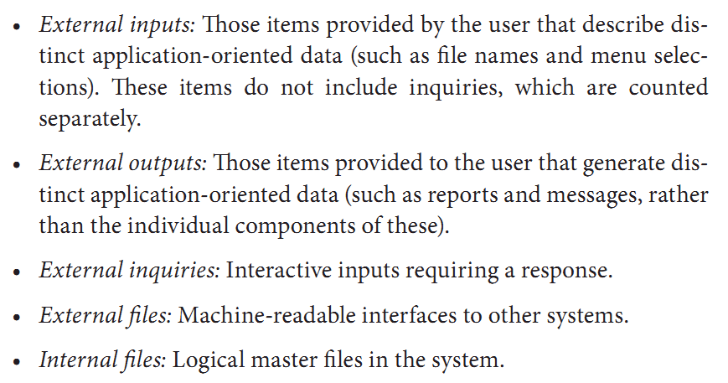
FUNCTIONAL SIZE MEASURES AND ESTIMATORS

Slide 11
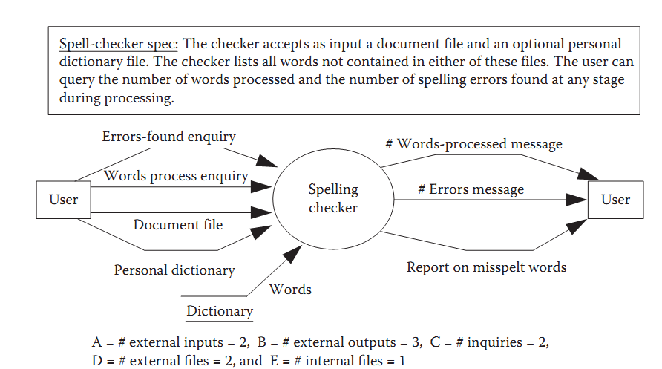
FUNCTIONAL SIZE MEASURES

Slide 12
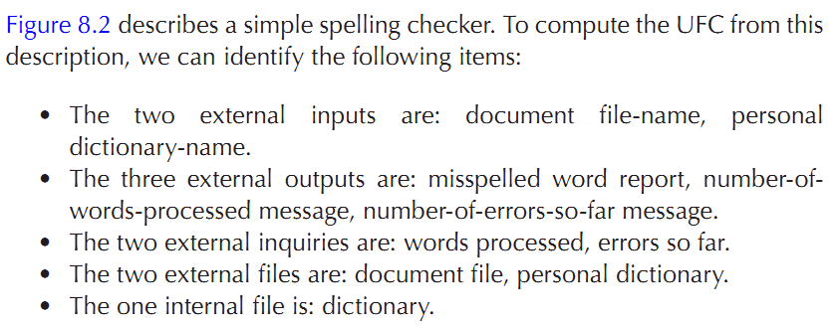
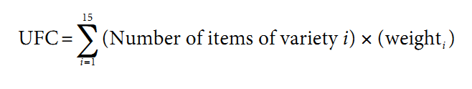
Example:8.11

Slide 13
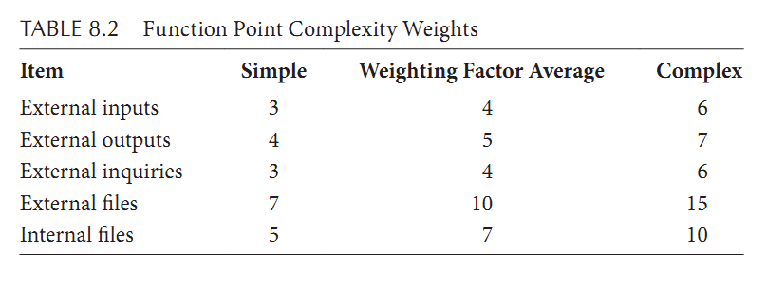
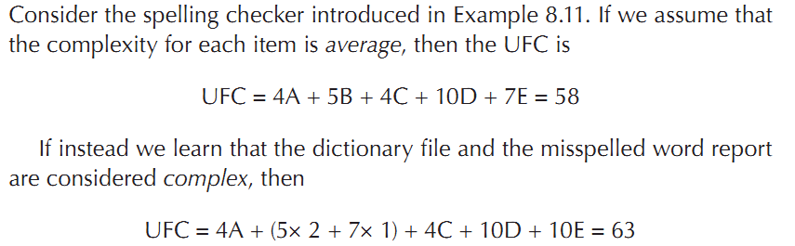
Unadjusted function point count (UFC)

Slide 14
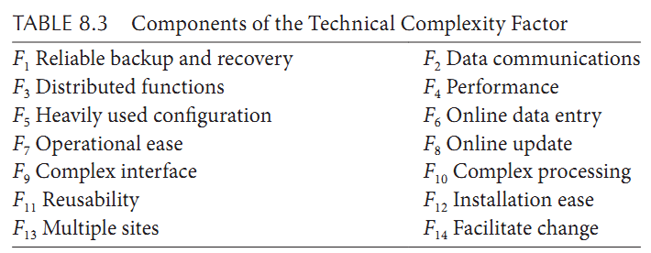
function-point count
To complete our computation of FPs, we calculate an adjusted function-point count, FP, by multiplying UFC by a technical complexity factor, TCF. This factor involves the 14 contributing factors listed in Table 8.3.

Slide 15
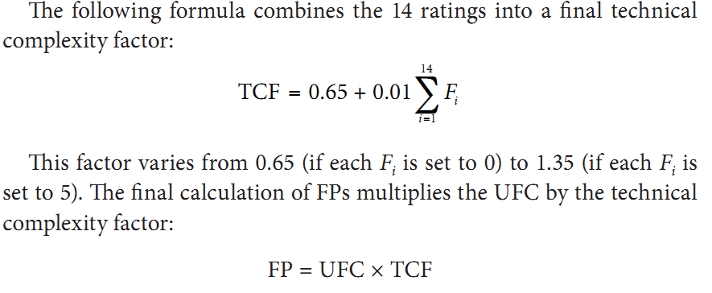
FP

Slide 16
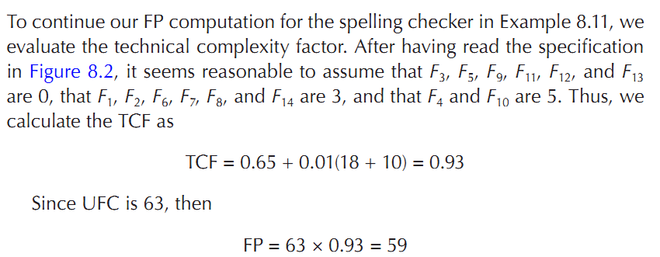
EXAMPLE 8.13: FP

Slide 17
Function Point Limitations
Problems with subjectivity in the technology factor.
Since the TCF may range from 0.65 to 1.35, the UFC can be changed by ±35%.
Problems with double counting.
It is possible to account for internal complexity twice: in weighting the inputs for the UFC, and again in the technology factor
Problems with accuracy.
Problems with changing requirements.
Problems with subjective weighting.

